Slide 1
Water Systems: Earth’s Supply of Water
Grade 8 Science Warden Ave PS

Slide 2
Learning Goals
By the end of this presentation we will be able to:
List the three states of water
List the main sources of water on Earth
Explain the water cycle
Define and explain Watersheds

Slide 3
States of Water
Water exists in three states:
Liquid
Solid
Gas
If you add enough heat to water, it evaporates turning it into gas (water vapour).
If you take away enough heat from water, it freezes into a solid (ice).

Slide 4
Facts About Earth’s Water
DID YOU KNOW??
97% of Water on Earth is Salt Water, which is undrinkable to humans!
Of the remaining 3% of Fresh water, almost ¾ is frozen in ice, with ground water making up most of the rest.
Lakes, Rivers and Wetlands (marshes, swamps and other land-based sources) only account for 0.34% of all the fresh water on earth!
Canada is one of the riches Fresh Water countries in the world.

Slide 5
Liquid Water
Liquid water is found above and below the ground. Surface Water
The Earth’s oceans are massive bodies of surface salt water with an avg. depth of 3.2 km
Surface Fresh Water is found in lakes, rivers, streams, etc… and can be used for hydro-electricity and household water usage.
We often store water in human-made creations like Water Towers, Artificial Lakes and Resevoirs.

Slide 6
Liquid Water (cont’d)
Underground Water
DYK??: Most of Canada’s fresh water is underground!
As rain falls, it soaks into the soil and flows between the soil particles. It drains down until it reaches a tough layer of clay or rock.
Once there, it pools up (meaning builds up) into an underground freshwater reservoir called an Aquifer. Many rural homes drill wells down into aquifers to get fresh water to use.
Eventually, the water flows towards a wetland, river, lake or ocean and joins that water source.

Slide 7
Solid Water
DID YOU KNOW??
All of the frozen water on Earth is fresh water!
While ocean water (salt water) can freeze, it’s freezing point is – 1.8 degrees Celsius.
It is estimated that the Earth’s glaciers and ice sheets contain more than 40 million Km ³
Most of the Earth’s fresh water exists as a solid state as either sheets of ice OR glacier mountains.

Slide 8
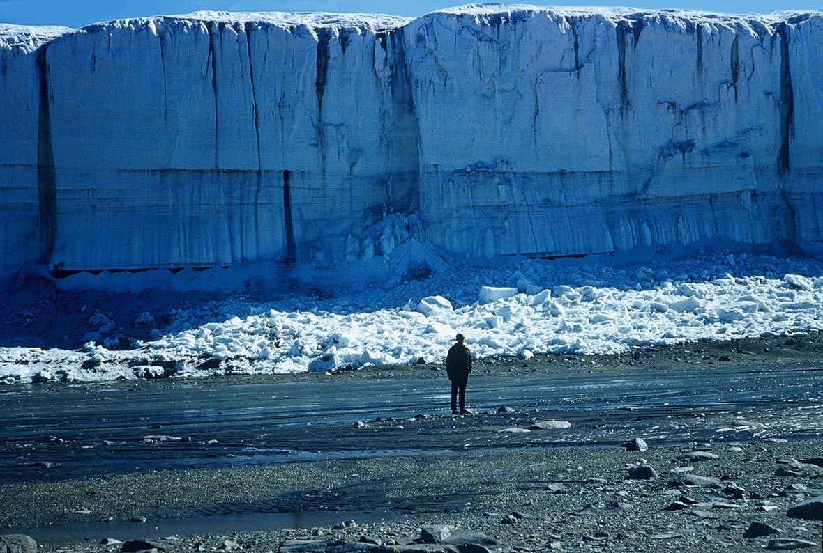
Mountain Glaciers
A Glacier is a mass of ice and overlaying (on top) snow that moves slowly down a mountain slope under the influence of gravity.

Slide 9
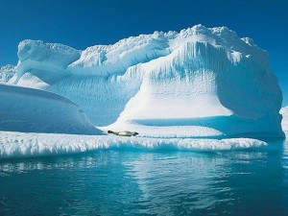
Mountain Glaciers cont’d
Glaciers are formed by centuries upon centuries of un-melted snow building up over time. As air spaces are squeezed out, the glacier hardens and builds up. This can take hundreds, if not thousands, of years to happen.

Slide 10
Gaseous Water
Water is also found in the atmosphere in a gaseous state. Through evaporation, clouds form and the water cycle continues.
Plants and animals also put water into the atmosphere during respiration.

Slide 11
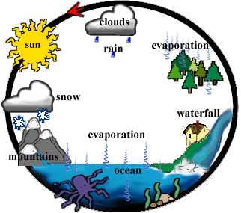
The Water Cycle

Slide 12
Watersheds
A watershed is an area of land where all the water eventually drains into one main water body, such as a stream, river, wetland, lake or ocean. Activities in one part of the watershed have an effect on other parts of the watershed.
As water cannot flow uphill, high points such as mountain ridges create natural divides in the flow of mountains.
Example: If you live West of the Rocky Mountains, all the watersheds flow to the Pacific Ocean.

Slide 13
Questions
In your own words, describe the water cycle.
In your own words, write definitions for Glacier, Aquifer and Watershed.
Pg. 289 # 1, 3, and 5

