Slide 1
Water Systems: Water and Weather
Grade 8 Science Warden Ave PS

Slide 2
Learning Goals
By the end of this presentation we will be able to:
Describe various effects water has on weather patterns and climate regions
Define the term Microclimate
Explain the effect of water bodies on Global climate
Explain the effect ice has on water systems

Slide 3
Climate VS Weather
Weather is the daily conditions in a particular area. Weather refers to the current conditions such as rain, clouds, sun etc…
Climate is the patterns that can be traced from year to year, or decade to decade , for a particular area. Canada is a cold climate country due to the fact that for years our average temperatures in Winter are below 0 degrees celcius.

Slide 4
How Water Moderates Air Temperature
As we all know, the sun’s rays reach the earth and provide heat. Depending on where they hit, that energy is absorbed at different rates.
Lakes and rivers have a higher Heat Capacity than the land around them. Heat capacity refers to the ability of a material to absorb heat.
Large bodies of water, such as lakes and rivers, help to moderate the temperature of the land around them by having a high heat capacity.

Slide 5
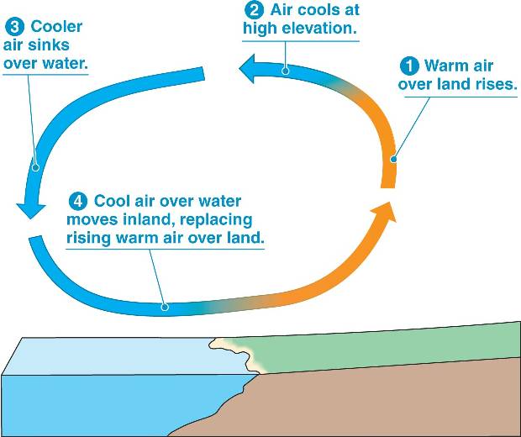
Moderation at Work
Water takes longer than air or land to absorb heat, BUT it also holds onto heat longer as well. This is as a result of it being in a liquid state, allowing for further dispersion of the particles.
During the day, or during summer, the land gets hotter than the water. When the warm air rises from the land, the cool air from the water blows in and replaces it, keeping the land at a moderate temperature.
The opposite is true at night or in the winter.

Slide 6
Water and Regional Climates
Now that we know how moderation can effect the climate of an area, let’s look at how water can affect so called “Microclimates”.
The Great Lakes are known to have a moderating effect on the areas around them. The closer you are to say Lake Ontario, the longer period you have of more moderate temperatures. This means that you can snow in one part of the GTA, like Barrie, but not have any snow in Toronto.
This idea of having a small area with a slightly different climate inside a larger climate region is called a Microclimate. These differences can be very small.

Slide 7
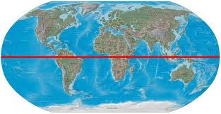
A Quick Note on Global Climate
As you can see, there is more water south of the equator.
As a result, the Southern Hemisphere has a more moderate climate, and as a result, warmer average temperatures.
The Southern Hemisphere is actually 81% ocean and only 19% land. Compare that with the Northern Hemisphere, which has 39% land and 61% oceans!

Slide 8
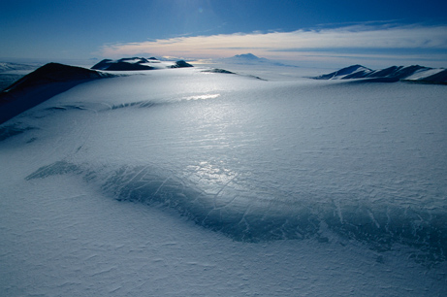
Effects of Ice on Water Systems
Scientific evidence suggests that Earth is approx. 4.5 Billion years old. During that time the earth has gone through natural heating and cooling periods. We are currently in a warming period (interglacial) that began over 11,000 years ago!!!

Slide 9
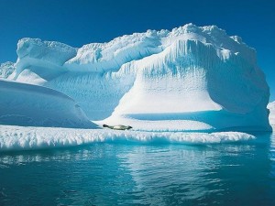
Effects cont’d
Glaciers grow temperatures are low and annual rainfall/snowfall increases. The opposite is also true, so that when temperatures rise and annual rain/snow fall decreases.

Slide 10
Weather’s Effect on Ice
When unusual weather lasts over several months (like snowing in April and May) it will affect the size of glaciers in that area. This is a one or two year result but NOT a dramatic change in climate.

Slide 11
Climate’s Effect on Ice
As we put more carbon dioxide and other gases into the atmosphere, we are contributing to what is called “The Greenhouse Effect”. This gradual warming of the earth can radically change the CLIMATE on earth.
While scientists haven’t yet been able to measure the full impact of this slow warming and gradual increase in the annual temperatures,
Ice sheets shrink during these periods of warming, releasing thousands of cubic litres of fresh water into our salt water oceans, changing the environment of the oceans.

Slide 12
Questions
Pg. 297# 2 and from the box at the bottom of the page #3.
Pg. 302 #4

